Slide 1
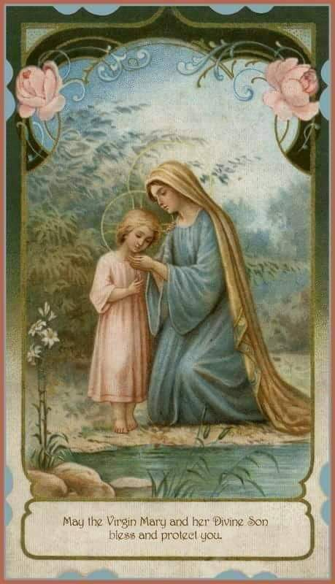
Mary of Nazareth
By Deacon Jeff Powers

Slide 4
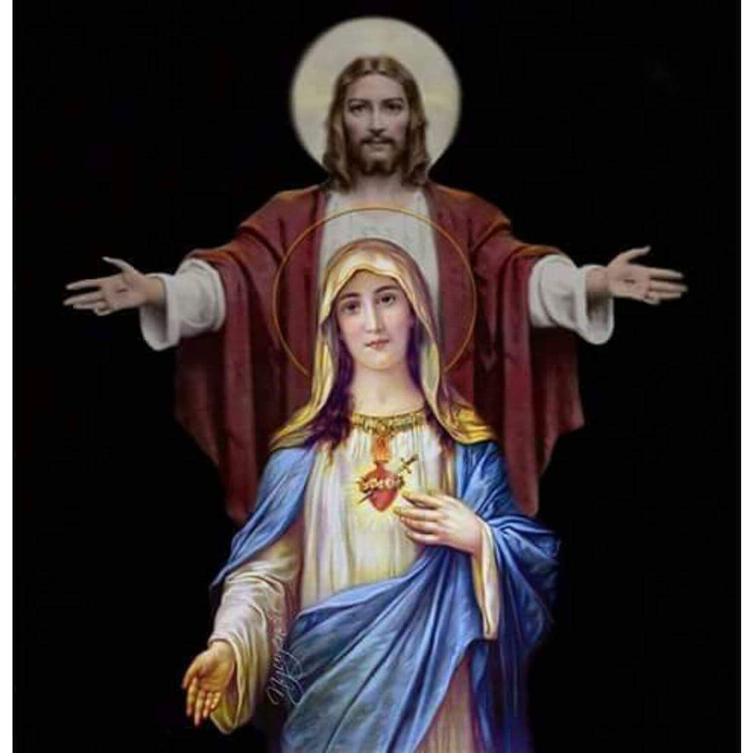
The Biblical Mary: The Annunciation

Slide 5
In the sixth month, the angel Gabriel was sent from God to a town of Galilee called Nazareth,
to a virgin betrothed to a man named Joseph, of the house of David, and the virgin’s name was Mary.
And coming to her, he said, “Hail, favored one! The Lord is with you.”
But she was greatly troubled at what was said and pondered what sort of greeting this might be.

Slide 6
Then the angel said to her, “Do not be afraid, Mary, for you have found favor with God. Behold, you will conceive in your womb and bear a son, and you shall name him Jesus. He will be great and will be called Son of the Most High, and the Lord God will give him the throne of David his father,
and he will rule over the house of Jacob forever, and of his kingdom there will be no end.”

Slide 7
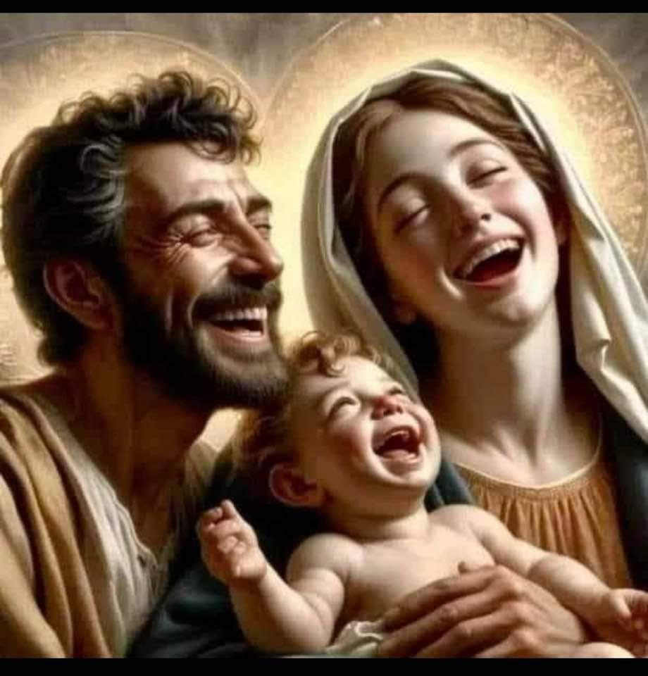

Slide 8
But Mary said to the angel, “How can this be, since I have no relations with a man?”
And the angel said to her in reply, “The holy Spirit will come upon you, and the power of the Most High will overshadow you. Therefore the child to be born will be called holy, the Son of God.”

Slide 9
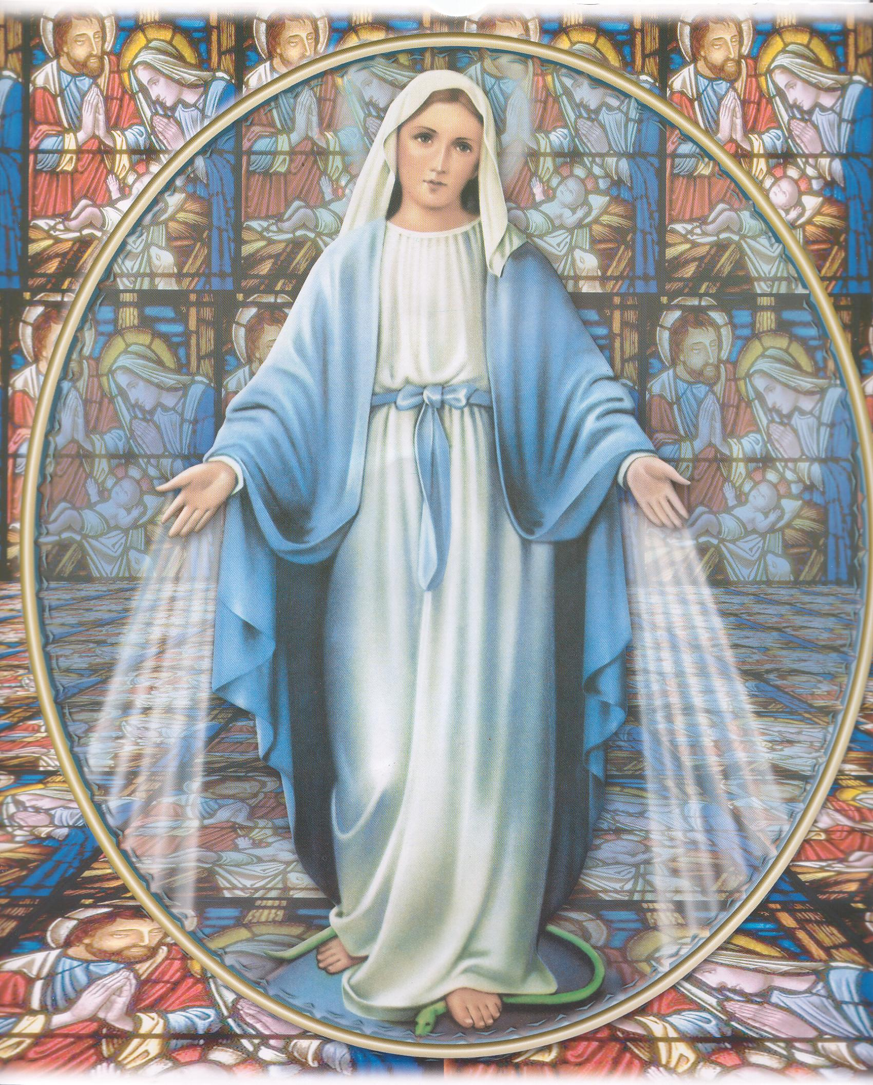
Mary Mother of God (Theotokos)

Slide 10
Dogmas (must be believed as a Catholic)
Mother of God
Immaculate Conception
Perpetual virginity
Assumption into heaven

Slide 11
Brothers and sisters…

Slide 12
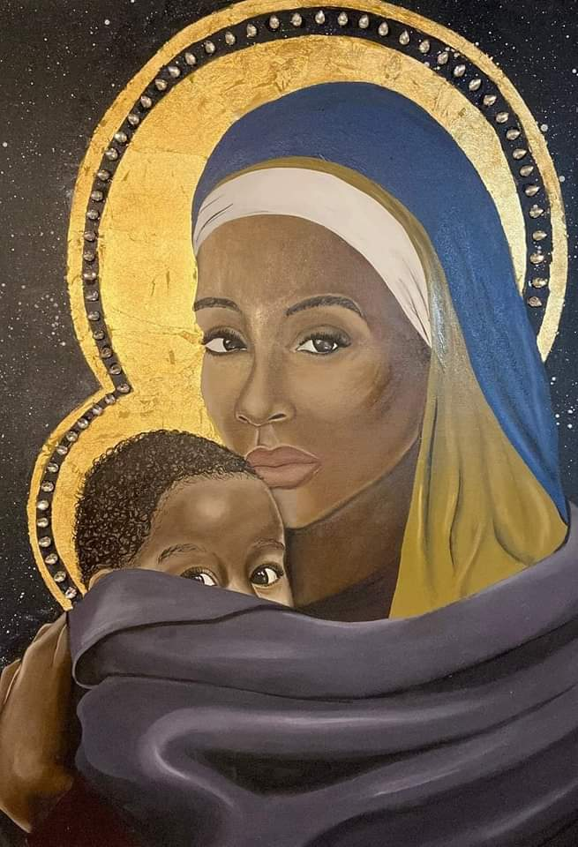
Connections….
When Jesus saw his mother* and the disciple there whom he loved, he said to his mother, “Woman, behold, your son.”
Then he said to the disciple, “Behold, your mother.” And from that hour the disciple took her into his home.

Slide 13
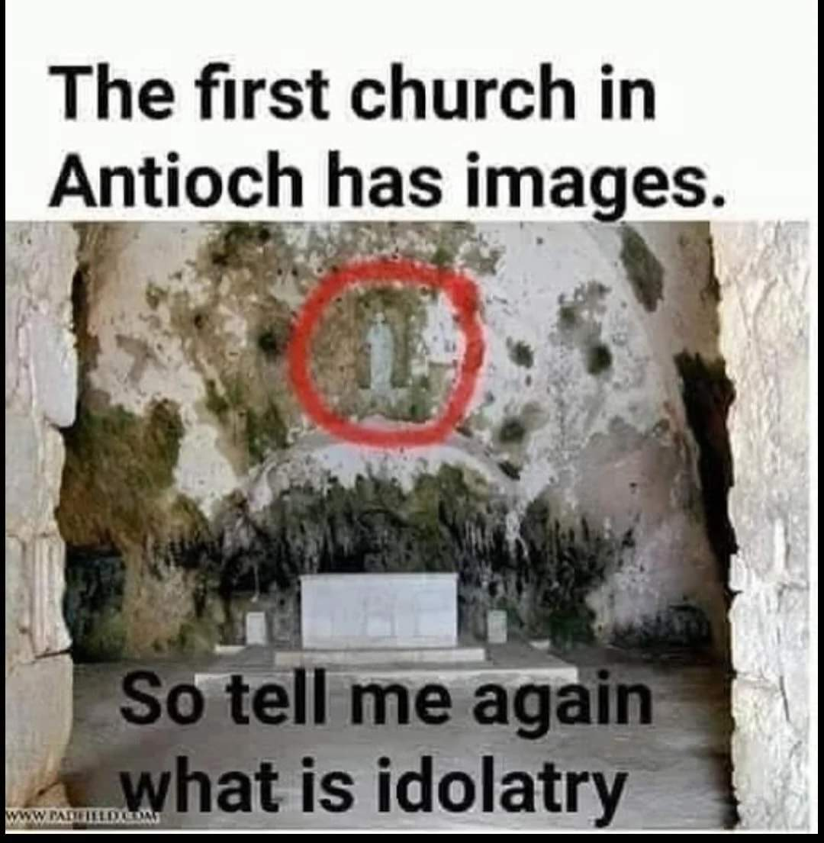

Slide 14
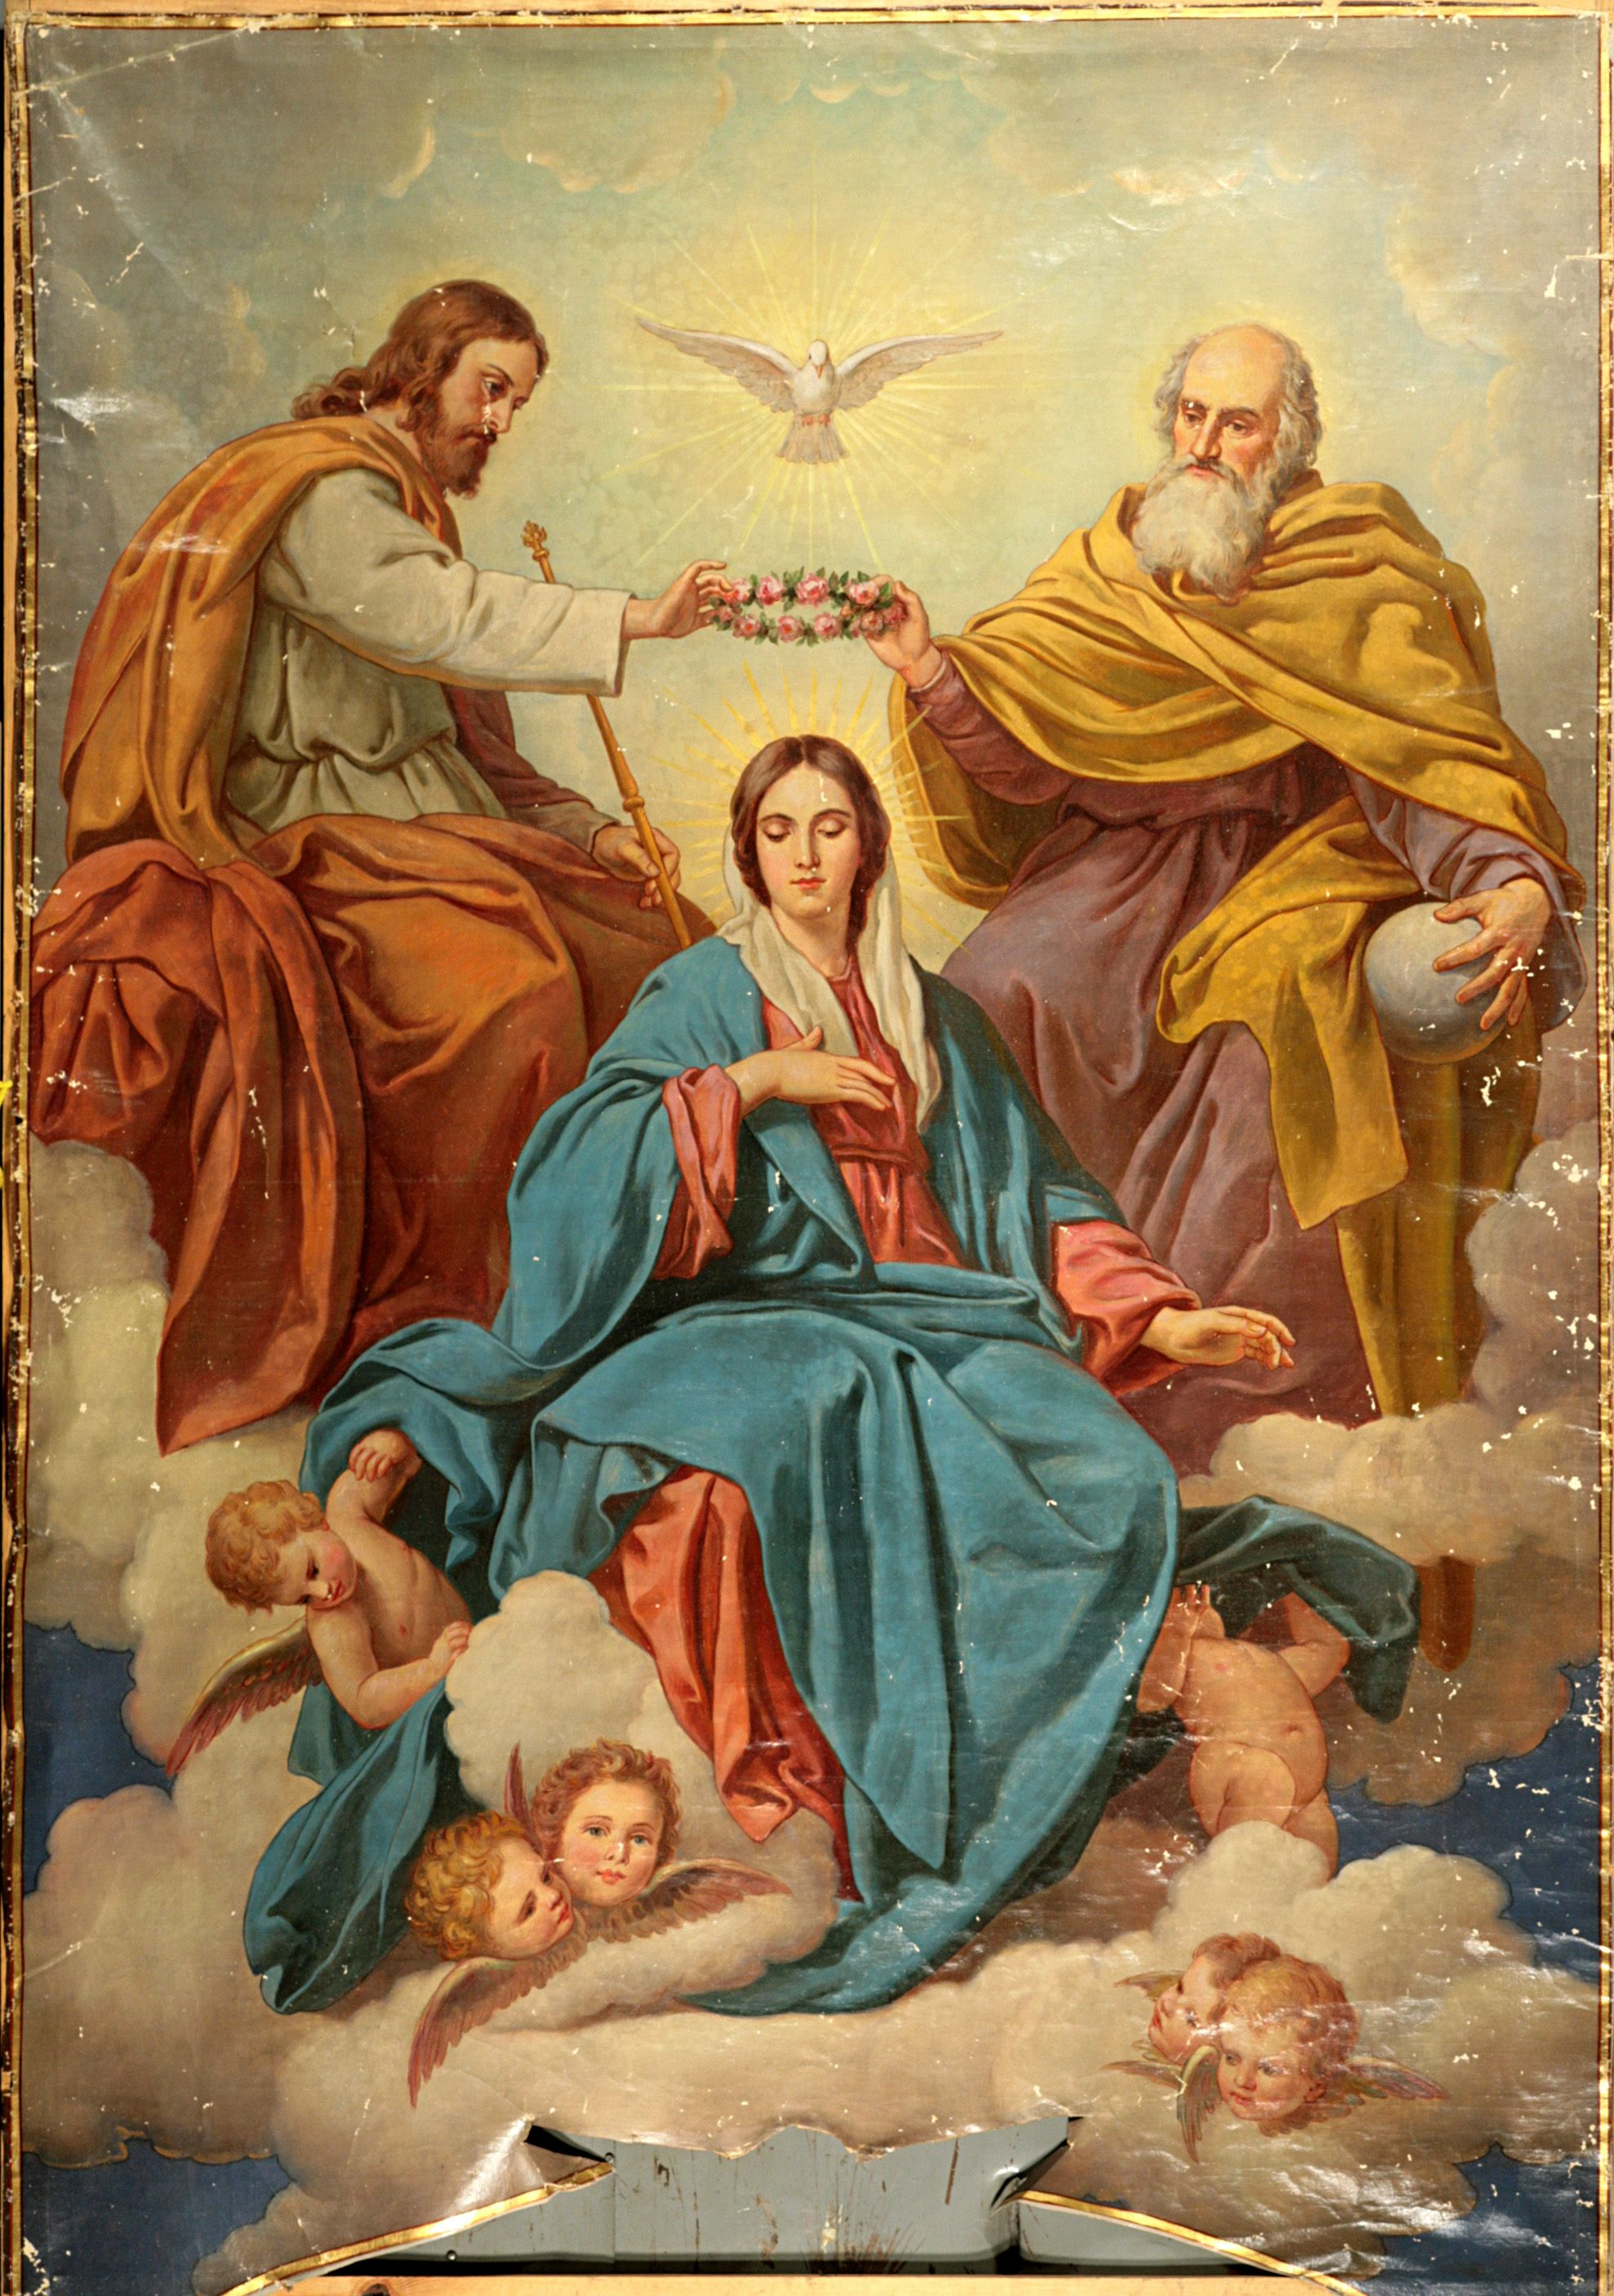
Private Revelation (apparitions)
There is only one woman – Mary – who gave birth to Jesus

Slide 16
The End

