Slide 1
25 – The Mass part 2 Liturgy of the Word
By Deacon Jeff Powers

Slide 2
What happens….
First Reading from the Old Testament
Gospel Proclaimed
Responsorial Psalm
Homily
Second Reading from an Epistle
Creed/Profession of Faith
Alleluia verse
Prayers of the Faithful
General Intercessions

Slide 3
Who does What
Lector: Person who does the readings
Lector can be almost anyone, usually a lay person
The alleluia verse is always sung
Lector(s) read the first reading and the second reading
The Gospel can ONLY be proclaimed by a Deacon
Lector may read the Psalm, or it is sung
The homily can only be given by clergy

Slide 4
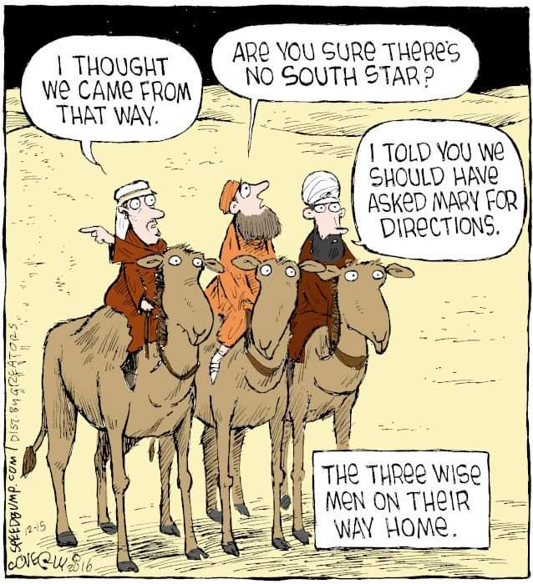
Each Mass has a “Theme”

Slide 5
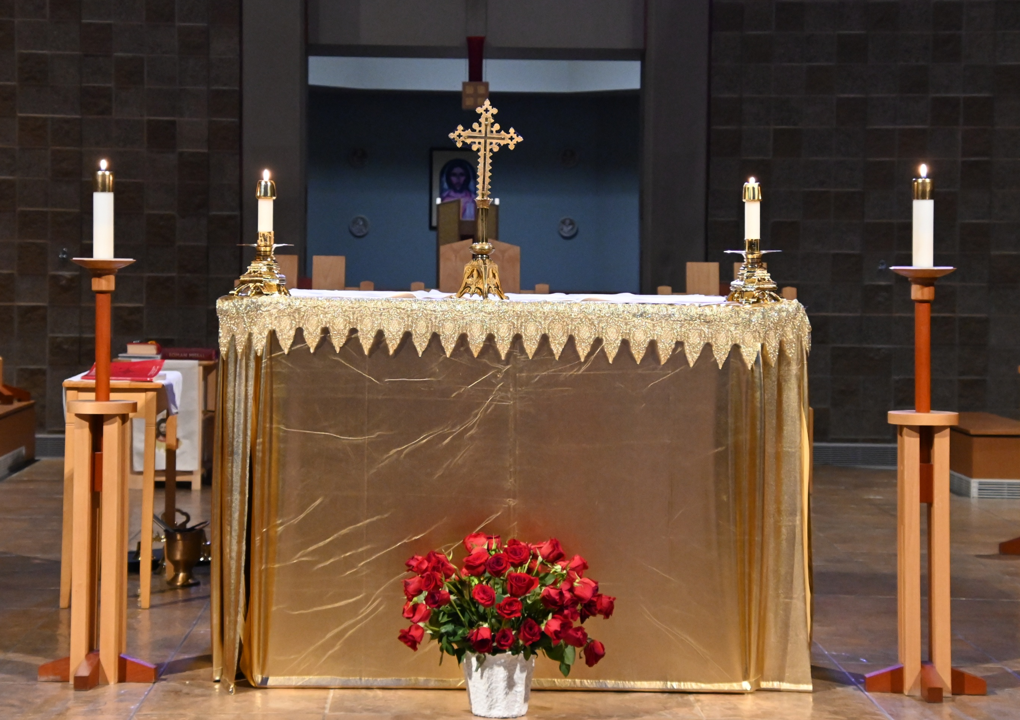
Take Sides!
Gospel Side
Epistle Side

Slide 6
Take Sides!

Slide 7
Take Sides!

Slide 8
Homily: Discussing the Word
Notice!

Slide 9
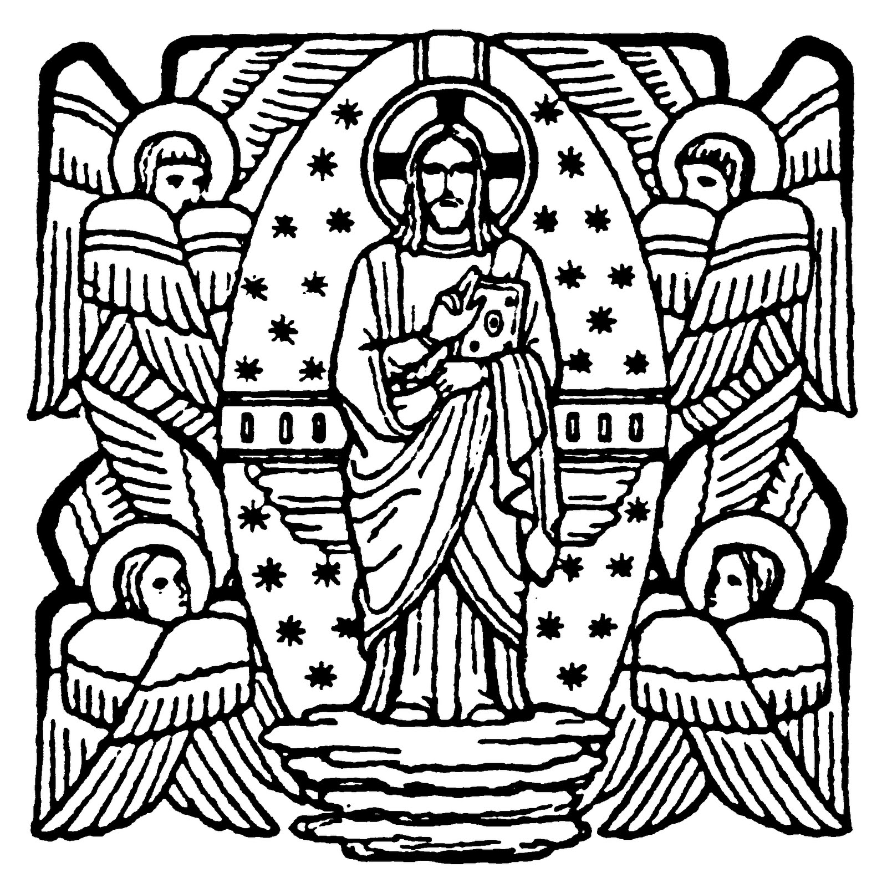
Credo: I Believe

Slide 10
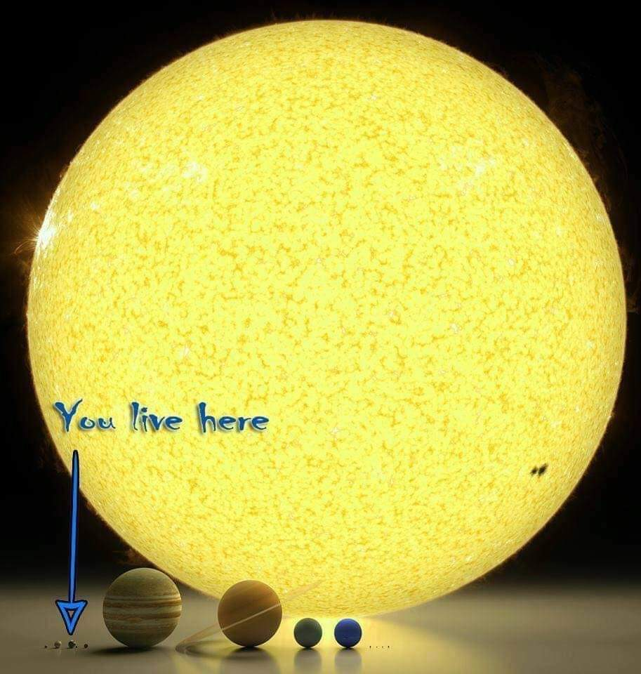
General Intercessions or Prayers of the Faithful

Slide 11
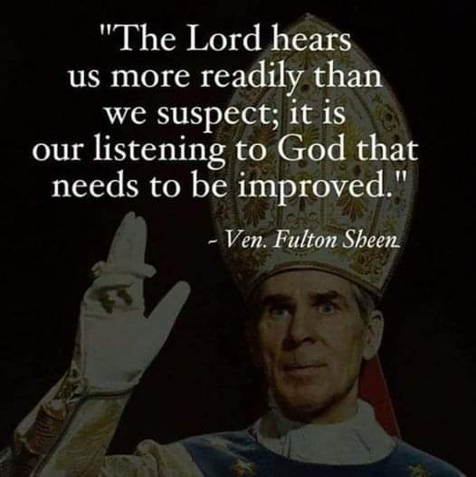
1 For the Church
2 For Political Leaders
3 For those in distress
4 For the sick
5 For the dead

Slide 12
The End

Slide 13
Sunday March 16th Rite of Sending
Thursday March 20th 7:30 pm (be there at 7) – Rite of Election St. Edward’s
Sunday March 23rd – 1st scrutiny
Sunday March 30th – 2nd Scrutiny
Sunday April 6th 9:30 am – 3rd scrutiny
Sunday April 13th – Palm Sunday
Saturday April 19th Easter Vigil Mass 8:30 (be there at 7:45)

